Slide 1
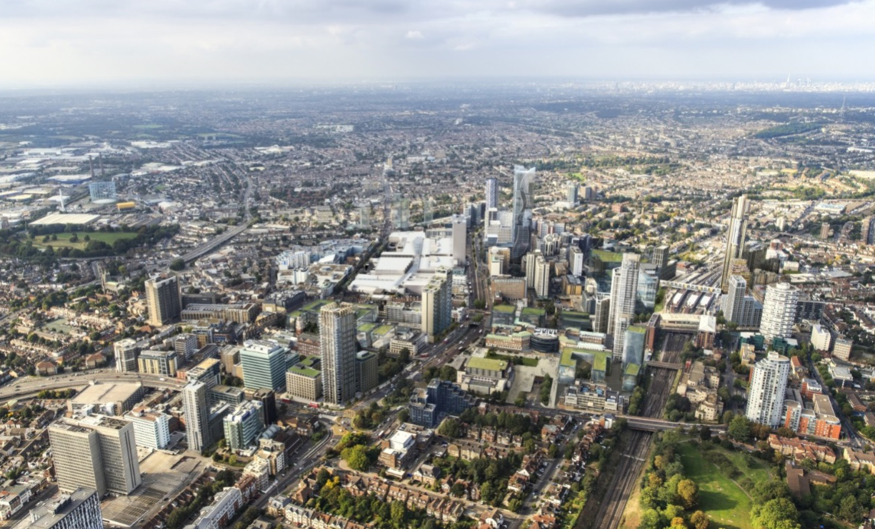



Tower Block Refurbishment Session
13 January 2023

Slide 2



Welcome

Slide 3
Welcome
Introduction to the team tonight
Focus on sharing information on what refurbishing the three tower blocks would involve
Part of the current statutory consultation on whether to refurbish or demolish the three tower blocks
Statutory consultation closes on 26 January and then reported to Council’s Cabinet

Slide 4


Project Finances
Croydon Council General Fund
Subject to the Section 114 notice which means that:
All non essential sending will be stopped
An emergency budget will be written up
Housing Revenue Account (HRA)
Ringfenced by statute and separate to the rest of the Council’s finances
Spend and income related to Council Housing is accounted for (and kept in) the HRA
Funding for the refurbishment or rebuild options will be through the HRA
Robin Smith

Slide 5
Our response to the report
Team of Housing Officers listening to residents door-to-door Drop-in facility and resident meetings Commissioning of Ridge & Partners Regular newsletter & bulletin Reference Group of residents Project Lead appointed, July 2022 Walkabout Action Plan, July 2022 Dedicated Tenancy & Repairs Officers | Weekly co-ordination of Council decisions Cease letting of flats Oct & Nov engagement, involving Mayor & Dep. Mayor at one session Cabinet Report authorising statutory consultation Independent Tenant & Leaseholder Adviser appointed by residents and launch of statutory consultation Engagement with residents mid December and throughout January

Slide 6
Ridge and Partners Brief
Initial Council Brief
Developed Brief
Undertake a full desktop review of all data that the Authority currently holds in relation to the building fabric, compliance, health and safety, repairs data planned works across the 26 tower blocks. Noted: the initial piece of works will be required to 5/6 blocks
Surveys will review and confirm the following:
Structural integrity of the building
General condition of stock and key components (Decent Homes Standard)
Fire safety requirements (from existing information no surveys are required)
General compliance, health, and safety (HHSRS)
The key outcome of this first stage is to understand the type, urgency, volume, and cost of works that need to be undertaken across the estate.
Undertake a full desktop review of all data that the Authority currently holds in relation to the building fabric, compliance, health and safety, repairs data planned works.
Undertake a Building Survey – We consider this to be the envelope i.e., Roofs, RWP’s where visible, External Walls and Windows. Communal areas but excluding external landscaping.
Inspections within dwellings will be required to achieve a portion of the brief, these tasks will focus on windows, general condition of the visible areas of the properties i.e., walls, ceilings, floors, sanitaryware, kitchens and general comments on services.
Undertake a structural inspection which consists of a site visit, desktop study of the client held record information make recommendations and report.
Review properties in relation to HHSRS compliance (however this will not be a full assessment and decent homes standards
Summarise the fire safety actions within the Type 4 FRA reports previous undertaken.
Provide outline budget estimates of costs.
Provide a clear conclusion with recommendations.
The deliverables will be summarised within a report format, which will include observations and recommendations for remedial works.

Slide 7

Methodology
Methodology driven by the brief:
Review of building history
Desktop review of record information including previous block refurbishment records, repairs history and fire risk assessments/cladding reports.
Notification to residents
Site inspection by Building Surveyors, Structural Engineers and Mechanical and Electrical Engineers
Evaluation of data
Develop report model and agreement of output.
Draft reporting, Partner review and LBC review
Final report

Slide 8

Summary of Common Block Findings
Elevation Option B - Remedial works to the existing cladding system including review and repairs to the fire breaks, upgrading the insulation, renew mastic joints and renew the render and insulation at ground level.
Windows - Renew the window to the dwellings with side hung casement windows to comply with the current building regulations.
Renew the common parts windows to comply with the current building regulations including AOV and window infill panels with fire rated units.
Roof Renewal - Remove the existing profile sheeting, insulation, and support structure etc. Strip the original flat roof covering. Supply and install new high performance felt to modern day standards
Lift motor/Tank roof - Remove the woodwool slab and supply and fit a new covering.
CCTV survey of the existing rainwater goods.
Re-line the existing rainwater down pipes and provide conservation outlets.
Elevations Option A - Remove the existing cladding system including insulation and supply and fit new insulated render system.

Slide 9

Summary of Common Block Findings
The electrical riser doors and frames should be renewed with certified fire rated doorsets.
Front Entrance Doors - Renew all existing front entrance doors with certified FD30 doorsets.
Refurbish the main entrance door and screen
Common Part Flooring - Renew common part flooring.
FRA Works – Should be implemented (Please see FRA and Cladding Report).
Clean and overhaul the existing AOV at the top of the stairs.
External entrance doors overhaul and decorate the rear entrance door.
Common Part Doors - The lift lobby doors and screens should be renewed with certified fire rated doorsets.
The meter cupboard doors and frames should be renewed with certified fire rated doorsets.
The internal refuse store doors and frames should be renewed with certified fire rated doorsets.

Slide 10

Summary of Common Block Findings
Investigations - Structural investigations
CCTV Above RWP and Below Ground Drainage Survey and renew SVP risers.
The following points will be included below the line as cost options:
Aluminium double-glazed windows replacement
Aluminium triple glazed window replacement
Cladding replacement with brick slips
Heat pump heating system
Lightning protection
Open up the lifts shafts to service each floor

Slide 11
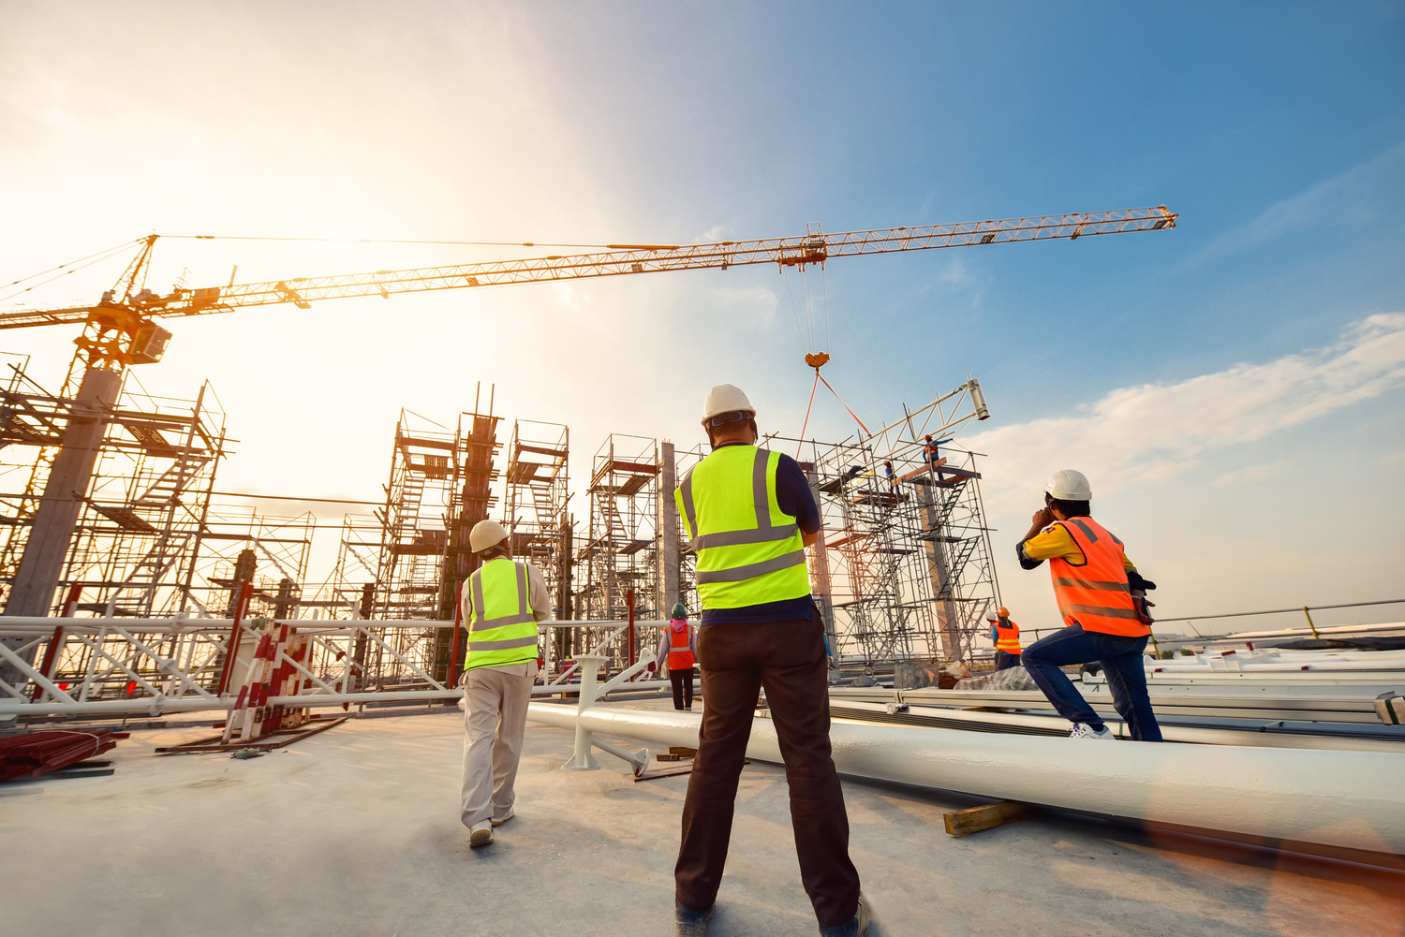
Structural Engineering
LPS Buildings are those constructed typically in the 1960’s and 70’s using large precast concrete panels for roofs, walls and floors.
The panels are joined together on site with additional steel reinforcement and insitu concrete.
Records indicate circa 160,000 dwellings were constructed using LPS in the UK.
The Croydon blocks are recorded as LPS blocks constructed using the Wates LPS system.
Large Panel System (LPS) Buildings
What are they?

Slide 12
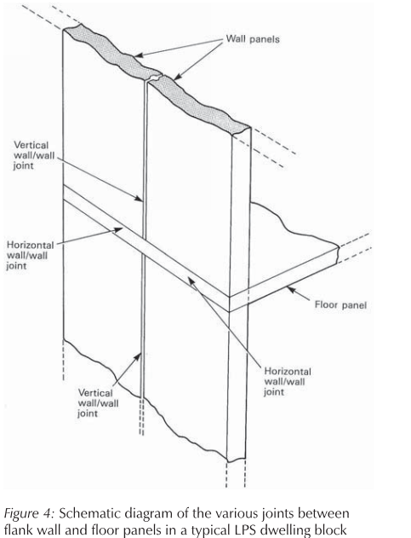

Structural Engineering
Large Panel System (LPS) Buildings
Typical construction

Slide 13
Structural Engineering
LPS buildings have inherent structural weaknesses in the panels and connections with failure to resist accidental forces such as explosion, impact, fire.
Many LPS structures have been demolished or strengthened dependent on the findings of individual structural engineering assessments (and associated costs).
In essence, the building structure needs to be assessed to see if it can resist accidental loads in accordance with latest BRE guidance.
Large Panel System (LPS) Buildings
Inherent design issues

Slide 14
Structural Engineering
This means that we need to investigate how the building was originally constructed and what loads the structural panels and connections can resist.
In the absence of original building records, we will need to undertake intrusive investigation to find reinforcement content throughout the building. Unfortunately, this work is noisy and disruptive.
Once we have this information, we can undertake a detailed assessment and determine what scale of strengthening is required (if any).
This strengthening will most likely involve erecting a steel frame to brace the structure and local strengthening of the panel joints. Again, this work will be noisy, disruptive, lengthy and expensive. A full decant will be required for this work to be undertaken safely.
Maintenance will be required for the structure throughout its design life to maintain its functionality, durability.
Large Panel System (LPS) Buildings
Structural assessment process

Slide 15
Structural Engineering
New legislation, The Building Safety Act 2022 dictates that the principal accountable person for any occupied higher-risk building will need to register the building and apply to the regulator for a building assessment certificate (Higher Risk Buildings are those greater than 18m or seven storeys).
In respect to structure, this will need to:
  1. Show that the building complied with applicable Building Regulations when constructed.
  2. Identify and manage building safety risks going forward and how the buildings structural integrity is being provided and maintained.
Once this has been successfully completed (along with other safety aspects such as Fire), a “building assessment certificate” will be granted.
Once this certificate is granted, the building can be occupied.
Large Panel System (LPS) Buildings
Building Safety Act 2022

Slide 16
Budget Costs
 | Refurbish | Per unit | Rebuild | Per unit
Ridge | £8,733,000 | £198,500* | £14,105,000** | £320,500**
Extra structural works | £3,600,000 – £13,912,000 (average £8,756,000) | £82,000 - £316,000 (average £199,000) | - | -
Total (with structural average) | £17,489,000 | £397,500* | £14,105,000** | £320,500**

Slide 17

Conclusion
We have undertaken an assessment of the visible structure and the available record information. We believe that the building integrity subject to detailed investigations at present is not a cause for concern.
We have assessed the key components Roof, External Walls, Windows, and Doors etc, all of these key components require major works, subject to further investigations and would fail the majority of the criterion under Decent Homes.
As noted within the report we have been unable to undertake a full HHSRS assessment and would recommend that the foregoing is undertaken, in order to understand the rating per dwelling including interaction with the residents. The discovery of mould within 90A which is classed as a Severe (Class I) hazard means that this property would be classified as failing to meet the minimum standards for housing. We believe that building would fail Decent Homes Standards, as noted above due to the four criteria not being met.
The Fire Safety works have been identified within Section 7 and all works should be implemented. We have acknowledged that a number of items have been addressed, however, a significant number appear outstanding, Croydon council have confirmed the works which have been completed (Appendix 5) Croydon have advised that the Fire Safety Engineer issuing EWS1 Forms has stated that the towers are tolerably safe in the interim. Croydon say that this is while the future of the towers is resolved. For the future, however, the works must be addressed satisfactorily if the towers are to remain.

Slide 18

Conclusion
The Type 4 FRA’s have also previously recommended a significant amount of investigation, which should be undertaken in order to inform the scope of works going forward.
Where available we have reviewed the relevant statutory documents made available to Ridge and Partners and commented on the adequacy or requirement for remedial works.
Short term all FRA fire actions should be addresses and all investigation works should be undertaken to clarify the elements which require opening up, which will inform the scheme going forward.

Slide 19

LBC Response
Desk top review of all available technical information, including relevant information from other Councils with LPS blocks
Broadly equivalent to BRE Assessment Stage 1 for Through-Life Management of LPS Dwelling Blocks
Resident Engagement – ‘Pull these blocks down now’
Comprehensive Damp and Mould Surveys imminent
Council obliged to conduct the legal process of Statutory Consultation before any decision on whether to refurbish or demolish

Slide 20


Questions
How strongly do you agree or disagree with the option of the Council continuing to refurbish homes within the consultation area?
How strongly do you agree or disagree with the option of the Council demolishing the three tower blocks so that modern replacement homes can be built?

Slide 21


AOB
Repeat session being held online on Monday, 16 January, 6pm to 8pm.
Please respond in writing to the statutory consultation by 5pm on Thursday, 26 January. The Independent Tenant and Leaseholder Adviser can assist.

